Slide 1
Introduction to Entity Framework Core In ASP.NET Core

Slide 2
ORM (OBJECT RELATIONAL MAPPING)
To address the data access requirements of ASP.NET CORE MVC application, you can use an ORM (Object Relational Mapping) framework.
Simplifies the process of accessing data from application.
ORM is a tool for storing data from domain objects to relational database.
Model
Class
SQL Server DB

Slide 3
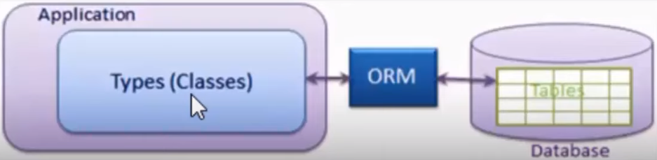
ORM (OBJECT RELATIONAL MAPPING)

Slide 4
EFC (ENTITY FRAMEWORK CORE)
Entity Framework Core is the new version of Entity Framework after EF 6 but it is redesigned.
It is open-source, lightweight, extensible and a cross-platform version of Entity Framework.
Entity Framework Core is a data access technology.
Entity Framework is an Object/Relational Mapping (ORM) framework.
Its is an enhancement to ADO.NET that gives developers an automated mechanism for accessing & storing the data in the database.
EF Core is intended to be used with .NET Core applications. However, it can also used with standard .NET 4.5+ framework based applications.

Slide 5
EF Core Development Approaches
EF Core Development Approaches
Code-First
Approach
Database-First
Approach

Slide 6
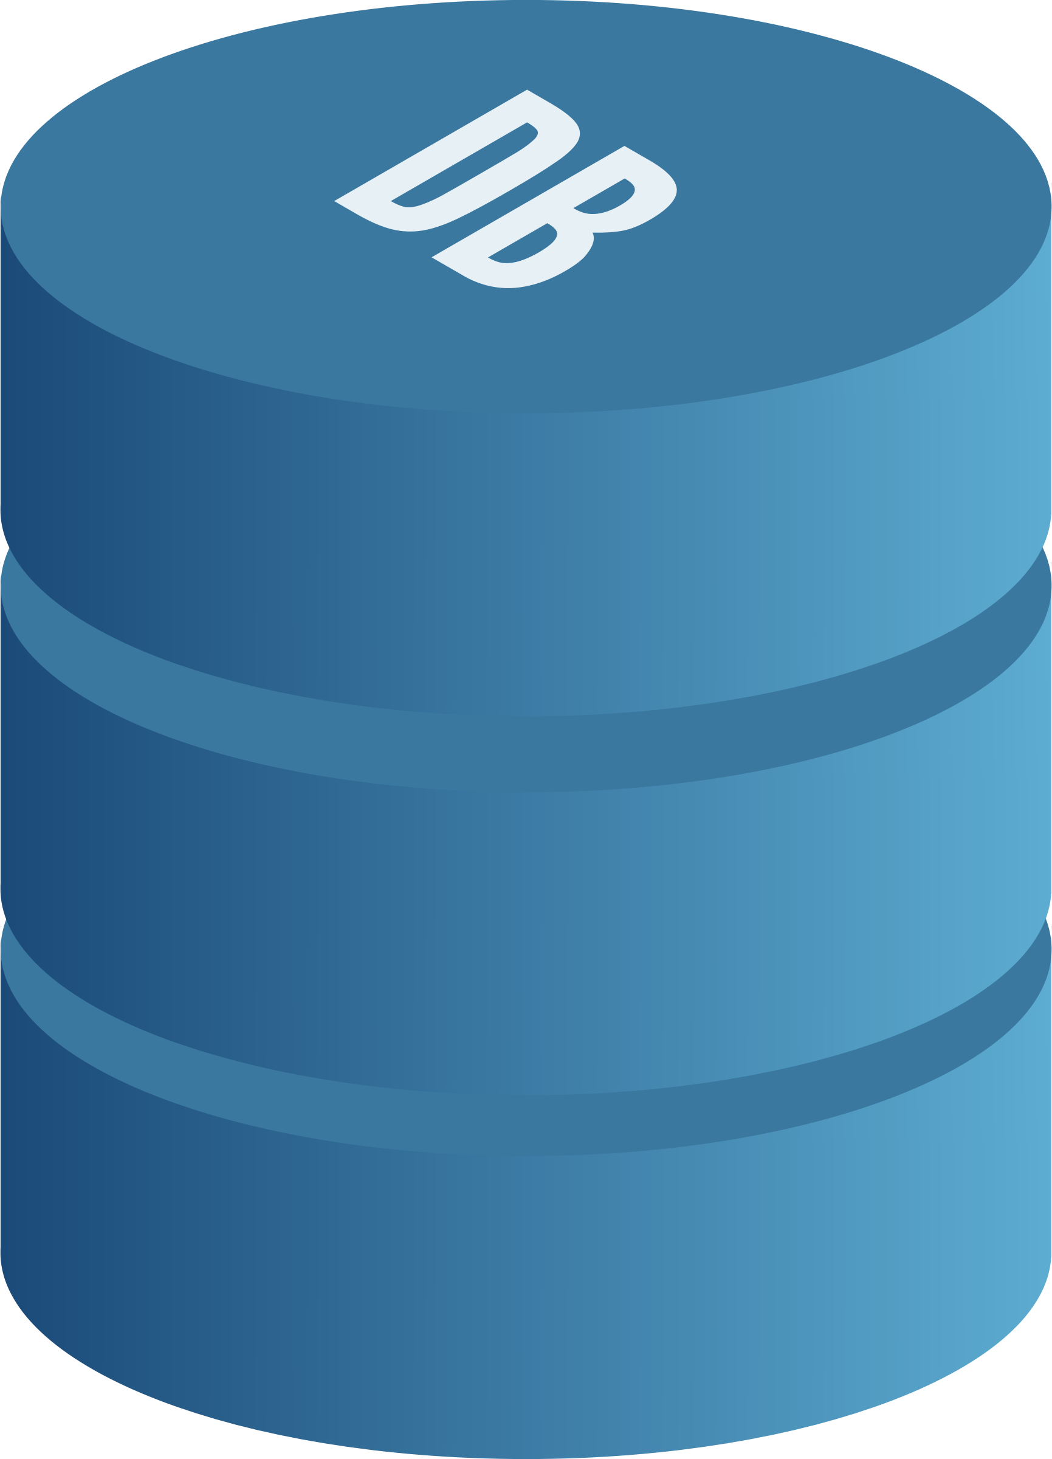
EF Core Database Providers
EF Core
Database
Provider
SQL
POSTGRE
SQL
MYSQL

